Slide 1
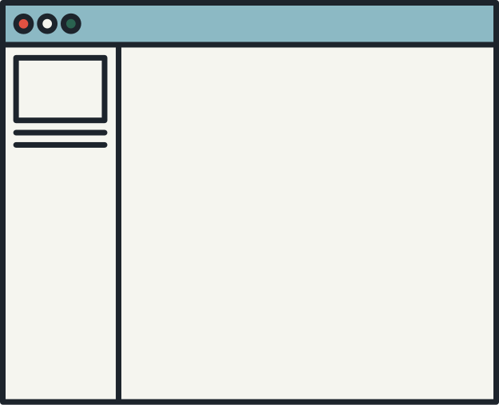



PHP PROGRAMMING

Slide 2



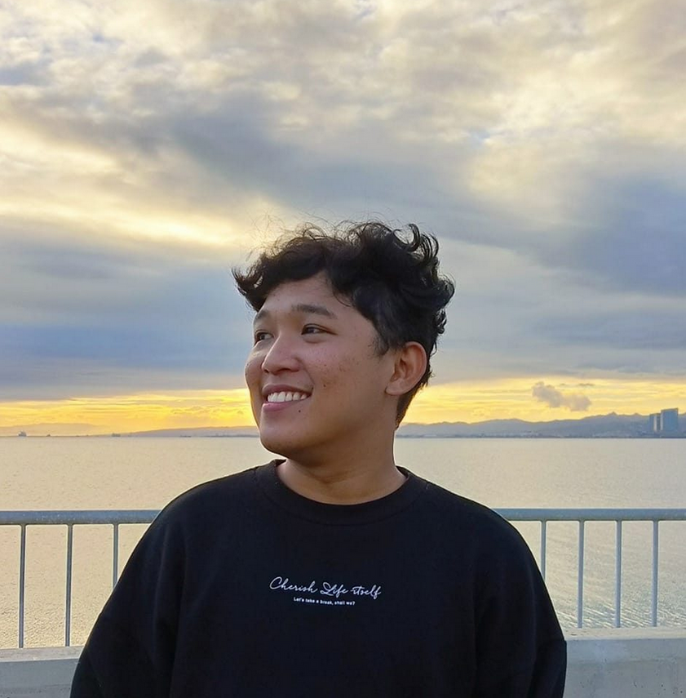


Slide 3


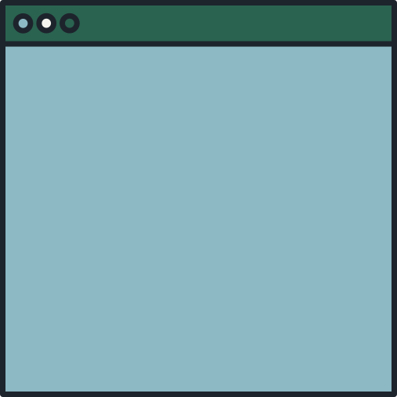
TODAY'S AGENDA
SETTING UP THE SOFTWARES
FRAMEWORK
MVC
REST API
CREATING API(CRUD)
INTEGRATING API TO VIEW

Slide 4







WHAT DO WE NEED?
PHP
LARAVEL
XAMPP
INSOMNIA
COMPOSER

Slide 5

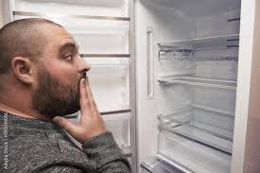

WHAT IS A FRAMEWORK?
IS A REUSABLE SET OF PRE-WRITTEN CODE THAT PROVIDES A STRUCTURE AND COMMON FUNCTIONALITY TO SUPPORT THE DEVELOPMENT OF SOFTWARE APPLICATIONS

Slide 6


PHP FRAMEWORKS
LARAVEL
CAKEPHP
CODE IGNITER

Slide 7

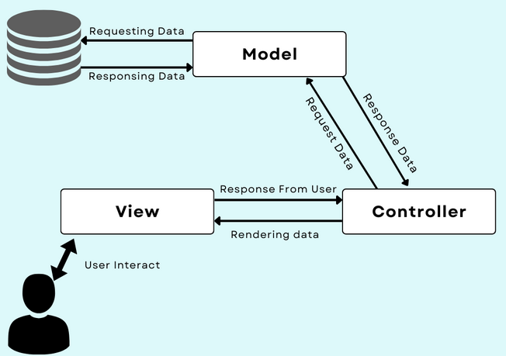

WHAT IS MVC?
MODEL
Communicates with the database
VIEW
Interacts with the User
CONTROLLER
Handles the logic of the system

Slide 8
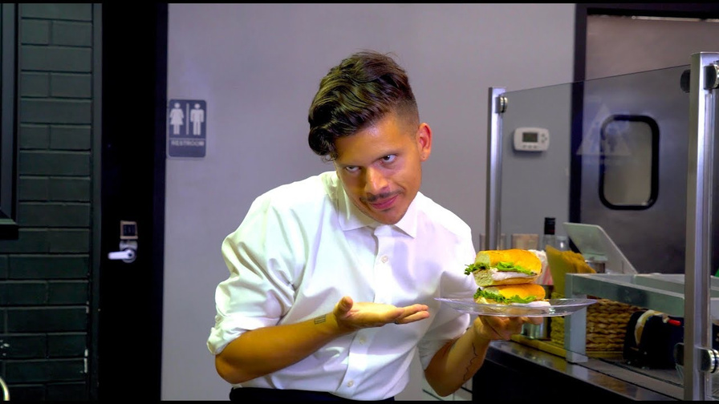
WHAT IS REST API?
APPLICATION PROGRAMMING INTERFACE
serve as bridges that allow software applications to communicate and share resources

Slide 9





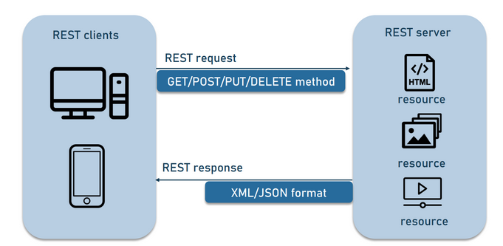
POST
CREATES A RESOURCE
GET
RETRIEVES A RESOURCE
PUT
UPDATES A RESOURCE
DELETE
DELETE A RESOURCE

Slide 10
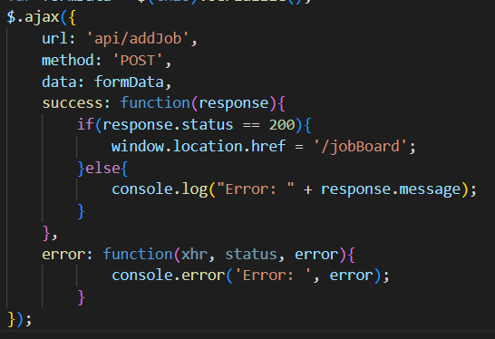

API INTEGRATION TO VIEW
<SCRIPT SRC="HTTPS://AJAX.GOOGLEAPIS.COM/AJAX/LIBS/JQUERY/3.6.0/JQUERY.MIN.JS"></SCRIPT>

Slide 11
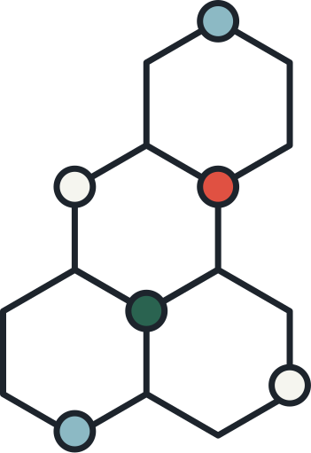


THANK YOU!

